Slide 1


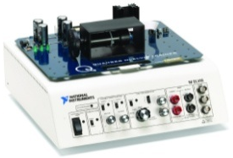


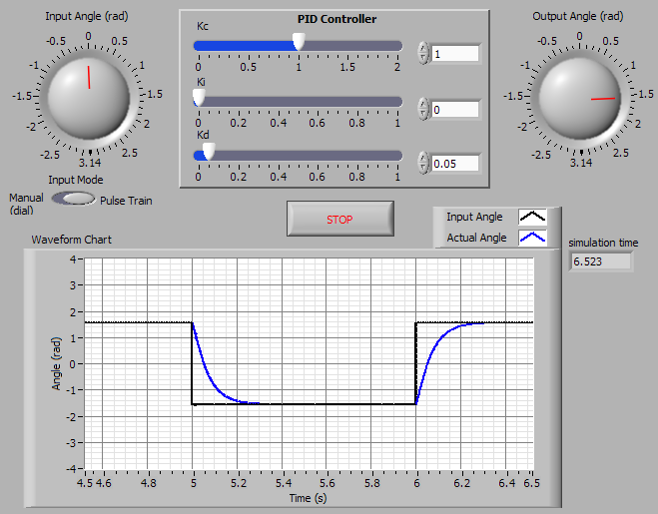
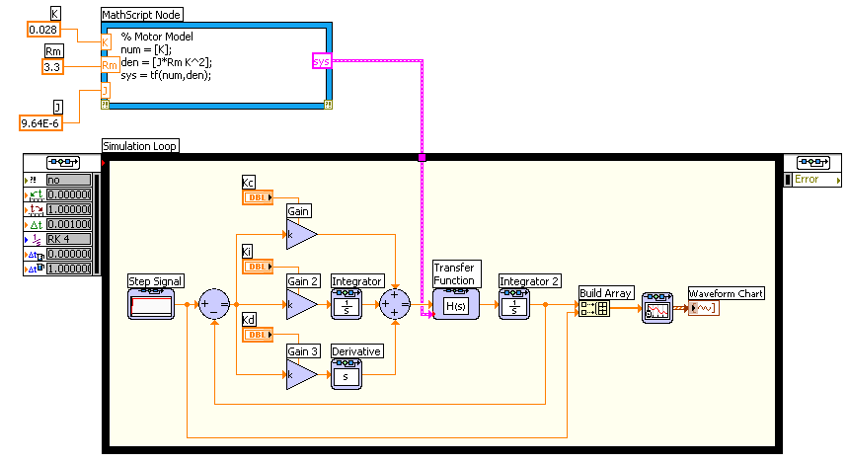
Introduction to
in 3 Hours
for Control Design and Simulation
+
_

Slide 2
Course Goals
Prerequisite: Learn LabVIEW 8 in 3 Hours
Requirements:
  LabVIEW 8.2 or later
  LabVIEW Control Design Toolkit 2.1 or later
  LabVIEW Simulation Module 8.2 or later
  (Optional) NI ELVIS & Quanser QNET DC Motor Hardware
Become comfortable with the LabVIEW Control Design Toolkit and Simulation Module
LabVIEW Concepts
  Construct transfer functions and build systems
  Develop a control algorithm and analyze its response
  Simulate a control algorithm with non-linear behavior
  Optimize algorithms through the interactive environment
Notes:
Prerequisite: Learn LabVIEW 8 in 3 Hours - http://zone.ni.com/devzone/cda/tut/p/id/5247
This is a list of the objectives of the course.
This course prepares you to do the following:
• Become comfortable with the LabVIEW Control Design Toolkit and Simulation Module.
• Use LabVIEW to solve control problems.
• Construct transfer functions and build systems.
• Develop a control algorithm and analyze its response.
• Simulate a control algorithm with non-linear behavior.
• Optimize algorithms through the interactive environment.
This course does not describe any of the following:
• Programming theory
• Every built-in LabVIEW function or object
NI does provide free reference materials on the above topics on ni.com.
The LabVIEW Help is also very helpful:
LabVIEW»Help»Search the LabVIEW Help…

Slide 3
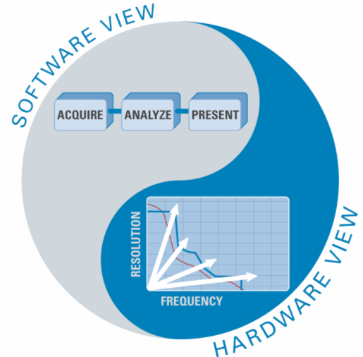
The Virtual Instrumentation Approach
Notes:
Virtual Instrumentation
For more than 25 years, National Instruments has revolutionized the way engineers and scientists in industry, government, and academia approach measurement and automation. Leveraging PCs and commercial technologies, virtual instrumentation increases productivity and lowers costs for test, control, and design applications through easy-to-integrate software, such as NI LabVIEW, and modular measurement and control hardware for PXI, PCI, USB, and Ethernet.
With virtual instrumentation, engineers use graphical programming software to create user-defined solutions that meet their specific needs, which is a great alternative to proprietary, fixed functionality traditional instruments. Additionally, virtual instrumentation capitalizes on the ever-increasing performance of personal computers. For example, in test, measurement, and control, engineers have used virtual instrumentation to downsize automated test equipment (ATE) while experiencing up to a 10 times increase in productivity gains at a fraction of the cost of traditional instrument solutions. Last year 25,000 companies in 90 countries invested in more than 6 million virtual instrumentation channels from National Instruments.

Slide 4

Virtual Instrumentation Applications
Design
  Signal and Image Processing
  Embedded System Programming
    (PC, DSP, FPGA, Microcontroller)
  Simulation and Prototyping
  And more…
Control
  Automatic Controls and Dynamic Systems
  Mechatronics and Robotics
  And more…
Measurements
  Circuits and Electronics
  Measurements and Instrumentation
  And more…
A single graphical development platform
Design
Prototype
Deploy
Notes:
Virtual Instrumentation Applications
Virtual instrumentation is applicable in many different types of applications, starting from design to prototyping and deployment. The LabVIEW platform provides specific tools and models to solve specific applications ranging from designing signal processing algorithms to making voltage measurements and can target any number of platforms from the desktop to embedded devices – with an intuitive, powerful graphical paradigm.
With version 8, LabVIEW scales from design and development on PCs to several embedded targets from ruggedized toaster size prototypes to embedded systems on chips. LabVIEW streamlines system design with a single graphical development platform. In doing so, LabVIEW encompasses better management of distributed, networked systems because as the targets for LabVIEW grow varied and embedded, you will need to be able to more easily distribute and communicate between various LabVIEW code pieces in your system.

Slide 5
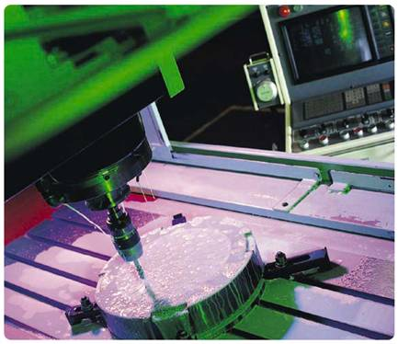



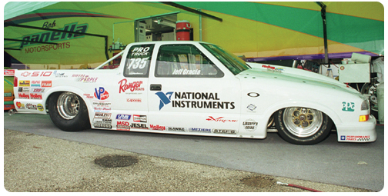
Spectrum of Control Applications
Industrial Control Embedded Control
Flight Control
Precision Machine Control
Process Control
Motion Control
Engine Control
Notes:
Control Applications
When discussing control systems, we are actually referring to a large range of applications. Probably even larger than you have suspected. First of all, control systems are commonly found in industrial environments. For example, consider an oil refinery with process control systems that continually manufacture and produce oil. The control system used for processing may consist of a Programmable Logic Controller (PLC) executing a PID algorithm, or a Distribute Control System (DCS) for a larger process control. In this case, the control system is used to manufacture a product.
A control system can also be part of an end product being manufactured. This has been seen primarily in the automotive and aerospace industries with electronic control units and flight control systems. However, control systems are now finding their way into other end products such as precision motor controllers for computer hard drives and white goods like washing machines.
While control systems used to manufacture a product often stem from established control strategies such as PID control, control systems embedded in end products often use new and innovative control strategies. The tools and techniques used to develop and embed control systems in end-products has evolved to include model-based design tools. However, manufacturing control engineers are also beginning to adopt these tools and techniques to develop more advanced control systems.

Slide 6
Topics Covered
A. Review: LabVIEW Environment
  Front Panel / Block Diagram
  Toolbar /Tools Palette
B. The Design Process
  Modeling
  Control Design
  Simulation
  Optimization
  Deployment

Slide 7
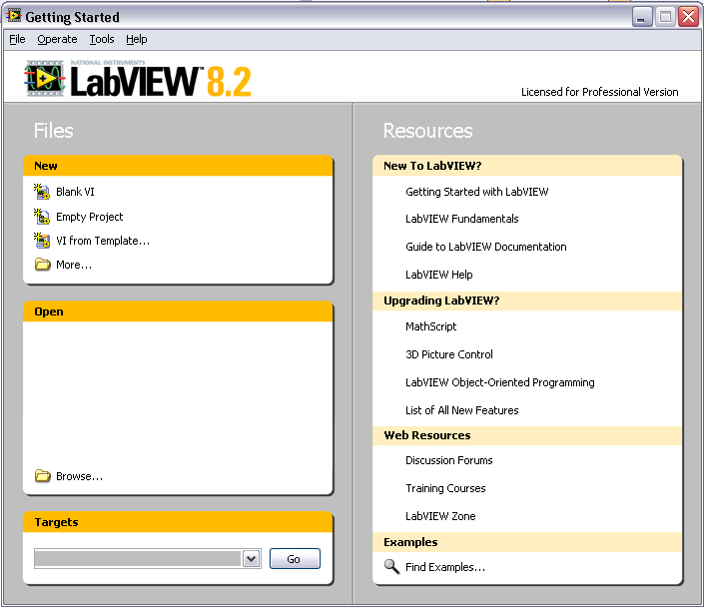
Review: Open and Run LabVIEW
Start » All Programs » National Instruments LabVIEW 8.2
»
Startup Screen:
Start from a Blank VI:
New » Blank VI
Start from an Example:
Examples » Find Examples…
or
Notes:
LabVIEW
LabVIEW is a graphical programming language that uses icons instead of lines of text to create applications. In contrast to text-based programming languages, where instructions determine program execution, LabVIEW uses dataflow programming, where the flow of data determines execution order.
You can purchase several add-on software toolkits for developing specialized applications. All the toolkits integrate seamlessly in LabVIEW. Refer to the National Instruments Web site for more information about these toolkits.
LabVIEW also includes several wizards to help you quickly configure your DAQ devices and computer-based instruments and build applications.
LabVIEW Example Finder
LabVIEW includes hundreds of example VIs you can use and incorporate into VIs that you create. In addition to the example VIs that ship with LabVIEW, you also can access hundreds of example VIs on the NI Developer Zone (zone.ni.com). You can modify an example VI to fit an application, or you can copy and paste from one or more examples into a VI that you create.

Slide 8
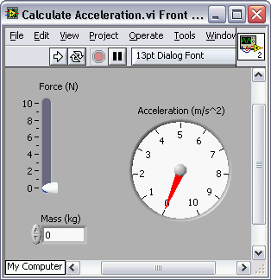
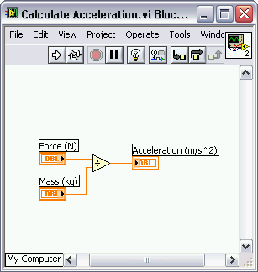
Review: Creating a Virtual Instrument
LabVIEW programs are called Virtual Instruments or VIs.
Each VI has two windows
  Front Panel → User Interface (UI)
    Controls = User Inputs
    Indicators = Outputs
  Block Diagram → Program Code
    Data travels on wires from controls through functions to indicators
    Blocks execute by Dataflow
Front Panel
Block Diagram
Notes:
LabVIEW programs are called virtual instruments (VIs).
Controls are inputs and indicators are outputs.
Each VI contains three main parts:
Front Panel – How the user interacts with the VI.
Block Diagram – The code that controls the program.
Icon/Connector – Means of connecting a VI to other VIs.
In LabVIEW, you build a user interface by using a set of tools and objects. The user interface is known as the front panel. You then add code using graphical representations of functions to control the front panel objects. The block diagram contains this code. In some ways, the block diagram resembles a flowchart.
Users interact with the Front Panel when the program is running. Users can control the program, change inputs, and see data updated in real time. Controls are used for inputs such as, adjusting a slide control to set an alarm value, turning a switch on or off, or to stop a program. Indicators are used as outputs. Thermometers, lights, and other indicators display output values from the program. These may include data, program states, and other information.
Every front panel control or indicator has a corresponding terminal on the block diagram. When a VI is run, values from controls flow through the block diagram, where they are used in the functions on the diagram, and the results are passed into other functions or indicators through wires.

Slide 9
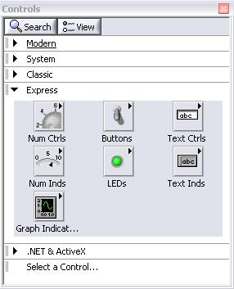
Review: Front Panel Controls Palette
(Controls & Indicators)
Control:
Numeric
Front Panel
Indicator:
Gauge
Notes:
Use the Controls palette to place controls and indicators on the front panel. The Controls palette is available only on the front panel. To view the palette, right-click on an open area in the front panel. Alternatively, select Window » Show Controls Palette. Tack down the Controls palette by clicking the pushpin on the top left corner of the palette.

Slide 10
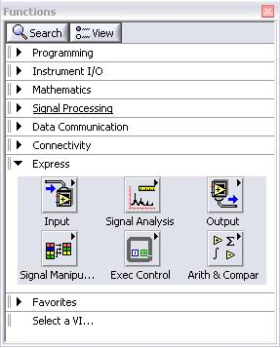
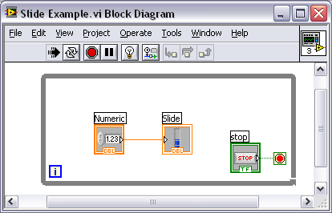
Review: Block Diagram Functions Palettes
Structure:
While Loop
Notes:
Use the Functions palette to build the block diagram. The Functions palette is available only on the block diagram. To view the palette, select Window»Show Functions Palette. You also can display the Functions palette by right-clicking an open area on the block diagram. Tack down the Functions palette by clicking the pushpin on the top left corner of the palette.

Slide 11
Review: Block Diagram Terminals
Front Panel Window
Block Diagram Window
Numeric Controls
Numeric Indicator
Notes:
When you create an object on the Front Panel, a terminal will be created on the Block Diagram. These terminals give you access to the Front Panel objects from the Block Diagram code.
Each terminal contains useful information about the Front Panel object it corresponds to. For example, the color and symbols provide information about the data type. For example: The dynamic data type is a polymorphic data type represented by dark blue terminals. Boolean terminals are green with TF lettering.
In general, blue terminals should wire to blue terminals, green to green, and so on. This is not a hard-and-fast rule; LabVIEW will allow a user to connect a blue terminal (dynamic data) to an orange terminal (fractional value), for example. But in most cases, look for a match in colors.
Controls have an arrow on the right side and have a thick border. Indicators have an arrow on the left and a thin border. Logic rules apply to wiring in LabVIEW: Each wire must have one (but only one) source (or control), and each wire may have multiple destinations (or indicators).

Slide 12





Review: Tools Palette
Recommended: Automatic Selection Tool
Tools to operate and modify both front panel and block diagram objects
Automatic Selection Tool
Automatically chooses among the following tools:
Operating Tool
Positioning/Resizing Tool
Labeling Tool
Wiring Tool
Notes:
If automatic tool selection is enabled and you move the cursor over objects on the front panel or block diagram, LabVIEW automatically selects the corresponding tool from the Tools palette. Toggle automatic tool selection by clicking the Automatic Tool Selection button in the Tools palette.
Use the Operating tool to change the values of a control or select the text within a control.
Use the Positioning tool to select, move, or resize objects. The Positioning tool changes shape when it moves over a corner of a resizable object.
Use the Labeling tool to edit text and create free labels. The Labeling tool changes to a cursor when you create free labels.
Use the Wiring tool to wire objects together on the block diagram.
Other important tools:

Slide 13

Review: Status Toolbar
Run Button
Continuous Run Button
Abort Execution
Additional Buttons on the Diagram Toolbar
Execution Highlighting Button
Retain Wire Values Button
Step Function Buttons
Notes:
Click the Run button to run the VI. While the VI runs, the Run button appears with a black arrow if the VI is a top-level VI, meaning it has no callers and therefore is not a subVI.
Click the Continuous Run button to run the VI until you abort or pause it. You also can click the button again to disable continuous running.
While the VI runs, the Abort Execution button appears. Click this button to stop the VI immediately.
Note: Avoid using the Abort Execution button to stop a VI. Either let the VI complete its data flow or design a method to stop the VI programmatically. By doing so, the VI is at a known state. For example, place a button on the front panel that stops the VI when you click it.
Click the Pause button to pause a running VI. When you click the Pause button, LabVIEW highlights on the block diagram the location where you paused execution. Click the Pause button again to continue running the VI.
Select the Text Settings pull-down menu to change the font settings for the VI, including size, style, and color.
Select the Align Objects pull-down menu to align objects along axes, including vertical, top edge, left, and so on.
Select the Distribute Objects pull-down menu to space objects evenly, including gaps, compression, and so on.
Select the Resize Objects pull-down menu to change the width and height of front panel objects.

Slide 14
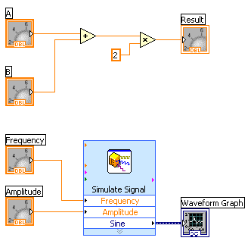
Review: Dataflow Programming
Block diagram execution
  Dependent on the flow of data
  Block diagram does NOT execute left to right
Node executes when data is available to ALL input terminals
Nodes supply data to all output terminals when done
Notes:
LabVIEW follows a dataflow model for running VIs. A block diagram node executes when all its inputs are available. When a node completes execution, it supplies data to its output terminals and passes the output data to the next node in the dataflow path. Visual Basic, C++, JAVA, and most other text-based programming languages follow a control flow model of program execution. In control flow, the sequential order of program elements determines the execution order of a program.
Consider the block diagram above. It adds two numbers and then multiplies by 2 from the result of the addition. In this case, the block diagram executes from left to right, not because the objects are placed in that order, but because one of the inputs of the Multiply function is not valid until the Add function has finished executing and passed the data to the Multiply function. Remember that a node executes only when data are available at all of its input terminals, and it supplies data to its output terminals only when it finishes execution. In the second piece of code, the Simulate Signal Express VI receives input from the controls and passes its result to the Graph.
You may consider the add-multiply and the simulate signal code to co-exist on the same block diagram in parallel. This means that they will both begin executing at the same time and run independent of one another. If the computer running this code had multiple processors, these two pieces of code could run independent of one another (each on its own processor) without any additional coding.

Slide 15
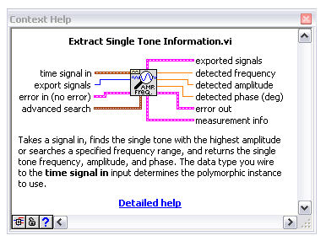

Review: Context Help Window
Help»Show Context Help, press the <Ctrl+H> keys
Hover cursor over object to update window
Additional Help
  Right-Click on the VI icon and choose Help, or
  Choose “Detailed Help.” on the context help window
Notes:
The Context Help window displays basic information about LabVIEW objects when you move the cursor over each object. Objects with context help information include VIs, functions, constants, structures, palettes, properties, methods, events, and dialog box components.
To display the Context Help window, select Help»Show Context Help, press the <Ctrl+H> keys, or press the Show Context Help Window button in the toolbar
Connections displayed in Context Help:
Required – bold
Recommended – normal
Optional – dimmed
Additional Help
VI, Function, & How-To Help is also available.
Help» VI, Function, & How-To Help
Right-click the VI icon and choose Help, or
Choose “Detailed Help.” on the context help window.
LabVIEW Help – reference style help
Help»Search the LabVIEW Help…

Slide 16
Review: Textual Math in LabVIEW
Integrate existing scripts with LabVIEW for faster development
Interactive, easy-to-use, hands-on learning environment
Develop algorithms, explore mathematical concepts, and analyze results using a single environment
Freedom to choose the most effective syntax, whether graphical or textual within one VI
Supported Math Tools:
MathScript script node MathSoft software
Mathematica software MATLAB® software
Maple software Xmath software
MATLAB ® is a registered trademark of The MathWorks, Inc.
Notes:
Overview
With the release of National Instruments LabVIEW 8, you have new freedom to choose the most effective syntax for technical computing, whether you are developing algorithms, exploring DSP concepts, or analyzing results. You can instrument your scripts and develop algorithms on the block diagram by interacting with popular third-party math tools such as The MathWorks Inc. MATLAB software, Mathematica, Maple, Mathcad, IDL and Xmath. Use of these math tools with LabVIEW is achieved in a variety of ways depending on the vendor as listed below:
Native LabVIEW textual math node:
MathScript node, Formula node
Communication with vendor software through LabVIEW node:
Xmath node, MATLAB script node, Maple* node, IDL* node
Communication with vendor software through VI Server:
Mathematica* VIs, and Mathcad* VIs
In LabVIEW 8, you can combine the intuitive LabVIEW graphical dataflow programming with MathScript, a math-oriented textual programming language that is generally compatible with popular m-file script language.
*LabVIEW toolkit specific to the math tool must be installed.
Math Node

Slide 17
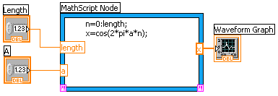
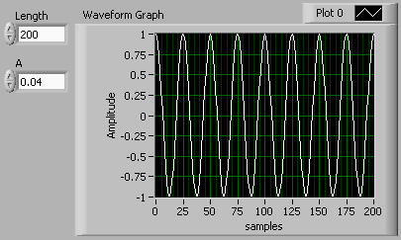
Review: Math with the MathScript Node
Implement equations and algorithms textually
Input and Output variables created at the border
Generally compatible with popular m-file script language
Terminate statements with a semicolon to disable immediate output
(Functions»Programming»
Structures»MathScript)
Prototype your equations in the interactive MathScript Window.
Notes:
The MathScript Node enhances LabVIEW by adding a native text-based language for mathematical algorithm implementation in the graphical programming environment. M-file scripts you’ve written and saved from the MathScript window can be opened and used in the MathScript node. M-file scripts you created in other math software will generally run as well. The MathScript allows you to pick the syntax you are most comfortable with to solve the problem. Equations can be instrumented with the MathScript Node for parameter exploration, simulation, or deployment in a final application.
The MathScript Node:
Located in the Programming»Structures subpalette.
Resizable box for entering textual computations directly into block diagrams.
To add variables, right-click and choose Add Input or Add Output.
Name variables as they are used in formula. (Names are case sensitive.)
The data type of the output can be changed by right-clicking the input or output node.
Statements should be terminated with a semicolon to suppress output.
Ability to import & export m-files by right-clicking on the node.

Slide 18
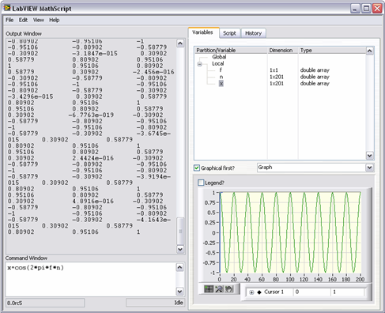
Review: The Interactive MathScript Window
Rapidly develop and test algorithms
Share Scripts and Variables with the Node
View /Modify Variable content in 1D, 2D, and 3D
Variable
Workspace
Output
Window
View/Modify
Variable Contents
m-file Script
User Commands
(LabVIEW»Tools»MathScript Window)
Notes:
The MathScript Window provides an interactive environment where equations can be prototyped and calculations can be made. The MathScript Window and Node share a common syntax and global variables making the move from prototype to implementation seamless. The data preview pane provides a convenient way to view variable data as numbers, graphically, or audibly (with soundcard support).
Help for MathScript
Help for the environment can be accessed using the Mathscript Interactive Environment Window. Type Help in the command window for an introduction to MathScript help. Help followed by a function will display help specific to that function.
Features of the interactive MathScript Window:
Prototype equations and formulas through the command Window
Easily access function help by typing Help <function> in the Command Window
Select a variable to display its data in the Preview Pane and even listen to the result
Write, Save, Load, and Run m-files using the Script tab
Share data between the MathScript Node in LabVIEW and the MathScript Window using Global Variables
Advanced plotting features and image export features

Slide 19
Review Exercise: Introduction to LabVIEW
Objectives:
Calculate the Acceleration given Force and Mass
Become familiar with the LabVIEW Environment
Notes:
Review Exercise: Introduction to LabVIEW
To begin our model, first we will make a simple model calculation of Newton’s classic F=m*a equation. Since we are interested in using Force and Mas as inputs, we will calculate a=F/m.
Create two front panel controls: a numeric control and a vertical slider.
Right click on the front panel to bring up the Controls Palette
Navigate to the Modern » Numeric sub-palette by left-clicking
Left click the Numeric control.
Left click on the Front Panel to place the control.
The name of the control will be highlighted. Start typing to rename this control to “Mass (kg)”
Repeat steps a-d with a Vertical Pointer Slide. Name this control “Force (N)”
Create a front panel gauge indicator.
In the Controls Palette, navigate to the Modern » Numeric sub-palette.
Select the Gauge indicator
Place and name this indicator “Acceleration (m/s²)”
Notice how corresponding terminals appeared on the white block diagram.
Place a divide function on the block diagram
In the Functions Palette, navigate to the Programming » Numeric sub-palette
Select and place the Divide function.

Slide 20
Hidden Notes Page
Notes:
Wire the controls and indicators to the Divide function
Hover the mouse on the right side of the Force control. The cursor will change to the wiring tool automatically.
Left click to begin a wire
Move the mouse to the top input of the divide function
Left-click to complete the wire
Repeat steps 1-4 to wire the Mass control to the Divide function’s bottom input and the output to the Acceleration indicator.
End of Exercise

Slide 21
The Design Process
Modeling – Identify a mathematical representation of the plant
Control Design – Choose a control method and design a controller
Simulation – Employ a point-by-point approach to simulate the system timing with a solver
Tuning and Verification – Introduce real-world nonlinearities, tune, and verify the control algorithm
Deployment – Implement the finalized control system
Notes:
The controller can be optimized by fully understanding the plant. This understanding comes from analysis done in the LabVIEW Control Design Toolkit. Specialized graphs, such as Bode, root-locus, and Nyquist plot, builds intuition of how the plant will behave. Further analysis using these plots with an open loop system with the controller allow stability and other characteristics to be calculated. In this way, we use Control Design to optimize the parameters, in our case the gains P, I, and D. Graphs in the time domain, such as the step response, provide immediate feedback on the ideal behavior of the system, such as rise time, overshoot, settling time, and steady-state error.
We then use the Simulation Module to validate these parameters under real world constraints. One prime example is the maximum and minimum voltage and current available to be supplied to the motor. The voltage limits of the motor define the linear range of operation. Outside of that range, the motor might be damaged or become unpredictable. This is an example of nonlinear behavior, which cannot be modeled using LTI analysis found in the Control Design Toolkit. The Simulation Module allows nonlinearities to be represented in the model. Voltage limits can be modeled using the Saturation block. Other nonlinear behaviors can be written in LabVIEW, MathScript, and the LabVIEW Formula Node, and integrated into the model as a Sub VI.
The optimization process usually includes several iterations between Control Design and Simulation to achieve the desired performance of the system.

Slide 22
Step 1:
Modeling
Identify a mathematical representation of the plant

Slide 23
The Design Process
Modeling – Identify a mathematical representation of the plant
Control Design – Choose a control method and design a controller
Simulation – Employ a point-by-point approach to simulate the system timing with a solver
Tuning and Verification – Introduce real-world nonlinearities, tune, and verify the control algorithm
Deployment – Implement the finalized control system
Create a model that describes the motor speed given an input voltage.
Notes:
The controller can be optimized by fully understanding the plant. This understanding comes from analysis done in the LabVIEW Control Design Toolkit. Specialized graphs, such as Bode, root-locus, and Nyquist plot, builds intuition of how the plant will behave. Further analysis using these plots with an open loop system with the controller allow stability and other characteristics to be calculated. In this way, we use Control Design to optimize the parameters, in our case the gains P, I, and D. Graphs in the time domain, such as the step response, provide immediate feedback on the ideal behavior of the system, such as rise time, overshoot, settling time, and steady-state error.
We then use the Simulation Module to validate these parameters under real world constraints. One prime example is the maximum and minimum voltage and current available to be supplied to the motor. The voltage limits of the motor define the linear range of operation. Outside of that range, the motor might be damaged or become unpredictable. This is an example of nonlinear behavior, which cannot be modeled using LTI analysis found in the Control Design Toolkit. The Simulation Module allows nonlinearities to be represented in the model. Voltage limits can be modeled using the Saturation block. Other nonlinear behaviors can be written in LabVIEW, MathScript, and the LabVIEW Formula Node, and integrated into the model as a Sub VI.
The optimization process usually includes several iterations between Control Design and Simulation to achieve the desired performance of the system.

Slide 24
Why Model?
A model represents a physical system
Inputs and outputs have real-world units
It is often a simplification of the system’s behavior
Many types of systems can be modeled
Mechanical systems
Electronic circuits
Analog and digital filters
Thermal and fluid systems
Models can be represented in many ways
Transfer function
State space
Others

Slide 25
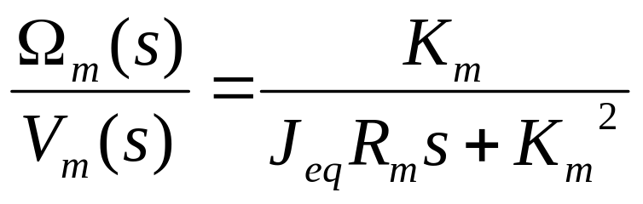
Modeling with the Transfer Function
A transfer function provides a mathematical description or model for how the Inputs and Outputs of a system are related.
In this case, the system is a motor.
Motor input is voltage
Motor output is angular velocity
In this case, the model of the system is derived from the physical model (using physics). An alternative would be to measure system response to stimulus and derive a model with LabVIEW System Identification Toolkit.
Notes:
Transfer function is the mathematical relationship between the output of the control system i.e. the plant and its input. Generally represented by the Laplace transform of the output of the system or plant divided by the Laplace transform of the plant’s input under the zero initial condition. We can also represent transfer function by Z-Transform.
The input and the output of a transfer function can be either mechanical or electrical parameters, in this case our system is motor, and the input to the system is voltage and the output from the system is angular velocity.
We can derive a transfer function of the physical model by using physics equations i.e. equations of motion, and so on; or can be estimated using tools like LabVIEW System Identification Toolkit.

Slide 26

QNET DC Motor Control Trainer
The model in this course is based on the
Quanser QNET DC Motor.
The motor is a 24 volt DC motor
The motor is highly linear in terms of its speed given a voltage
We will use the Control Design Toolkit functions to create the mathematical model in LabVIEW

Slide 27

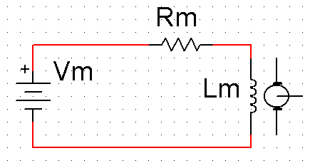


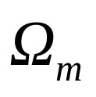






Deriving the Motor Model
Electrical
1.
2.
3.
Mechanical
4.
5.
6.
7.
Motor Diagram
Fixed Magnets
Motor Coil
Brushes
Drive Shaft
Encoder
Inertial Mass
Motor model derivation from Quanser QNET Interactive Learning Guide. Copyright ©2005, by Quanser Inc. All rights reserved.
Notes:
The model for the DC motor is derived from the electrical and mechanical characteristics of the system. The input to the motor is voltage (V_{m}), and the output from the motor is angular velocity (ω_{m}). The transfer function that defines the motor model is the ratio between the Laplace transforms of the input and output:
(Ω_{m}/V_{m})=k_{m}/(R_{m*}J_{eq*}s+k_{m}²)
Where:
k_{m} = Motor back-EMF constant (V/(rad/s))
R_{m} = Motor armature resistance (Ohms)
J_{eq} = Equivalent moment of inertia (kg*m²) (Assume that J_{eq}=J_{m}(Motor armature moment of inertia))
This transfer function makes up the Plant model that will be used throughout the exercises in this course. The Plant model will be used to design a Controller model, which can then be tested with the actual motor.

Slide 28

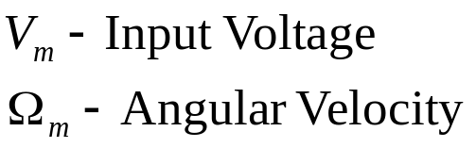

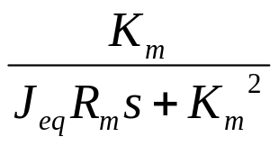

Motor Specifications Sheet
Symbol | Description | Value | Unit
Motor:
R_{m} | Motor armature resistance. | 3.30 | ohms
K_{t} | Motor torque constant. | 0.0280 | N.m
K_{m} | Motor back-emf constant | 0.0280 | V/(rad/s)
J_{m} | Moment of inertia of motor rotor | 9.64e-6 | kg.m²
M_{l} | Inertial load disc mass | 0.033 | kg
r_{l} | Inertial load disc radius | 0.0242 | m
Pulse-Width Modulated Amplifier:
V_{max} | PWM amplifier maximum output voltage | 24 | V
 | PWM amplifier maximum output current | 5 | A
 | PWM amplifier gain | 2.3 | V/V
Motor model specifications from Quanser QNET Interactive Learning Guide. Copyright ©2005, by Quanser Inc. All rights reserved.

Slide 29
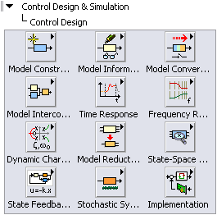

LabVIEW Control Design Toolkit
Construct and analyze system models
Design basic and advanced control algorithms
Simulate response of controller designs
Analyze control efficiency and stability interactively

Slide 30
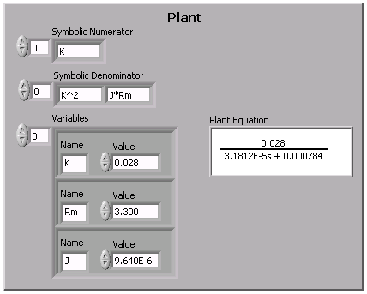
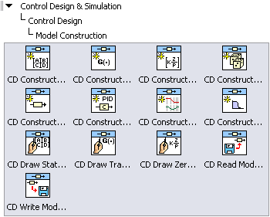

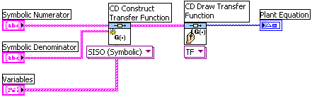
Constructing Models Graphically
Create continuous and discrete time models
Models can be created symbolically
Notes:
Use the Model Construction VIs to graphically create linear system models and modify the properties of a system model. You also can use the Model Construction VIs to save a system model to a file, read a system model from a file, or obtain a visual representation of a model.
The first step in working with the Control Design toolkit is inputting a model to work with. The Control Design Toolkit can work with Transfer Function (TF), State Space (SS), and Zero Pole Gain (ZPK) models. The model itself is stored as a cluster which can be passed from VI to VI to perform multiple operations on a single model.

Slide 31
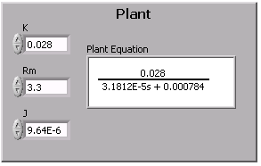
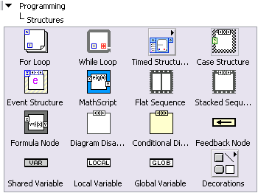

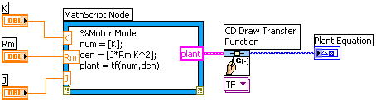
Constructing Models Textually
MathScript allows models to be created using m-file syntax.
Notes:
Models can be constructed using a text-based language with the Control Design MathScript functions. Use the MathScript Node to define a region on the block diagram for textual programming. MathScript can work with Transfer Function (TF), State Space (SS), and Zero Pole Gain (ZPK) models. The cluster containing the model information produced by the MathScript Node has the same form as the cluster produced by the Model Construction VIs, allowing for interchangeable use of textual and graphical programming.

Slide 32


Exercise 1a:
Create and Display a Transfer Function
Use physical specifications to create a plant model.
Build a transfer function with Control Design Toolkit.
Notes:
Exercise Instructions can be found at the end of PDF version of this manual or independently as “Updated Exercise Instructions.pdf”.

Slide 33
Exercise 1b:
Create and Display a Transfer Function
Use physical specifications to create a plant model
Build a transfer function with Control Design Toolkit
Notes:
Exercise Instructions can be found at the end of PDF version of this manual or independently as “Updated Exercise Instructions.pdf”.

Slide 34
Step 2:
Control Design
Choose a control type and design a controller

Slide 35
The Design Process
Modeling – Identify a mathematical representation of the plant
Control Design – Choose a control method and design a controller
Simulation – Employ a point-by-point approach to simulate the system timing with a solver
Tuning and Verification – Introduce real-world nonlinearities, tune, and verify the control algorithm
Deployment – Implement the finalized control system
Use feedback to control the speed of the motor in the presence of disturbances.
Notes:
The controller can be optimized by fully understanding the plant. This understanding comes from analysis done in the LabVIEW Control Design Toolkit. Specialized graphs, such as Bode, root-locus, and Nyquist plot, builds intuition of how the plant will behave. Further analysis using these plots with an open loop system with the controller allow stability and other characteristics to be calculated. In this way, we use Control Design to optimize the parameters, in our case the gains P, I, and D. Graphs in the time domain, such as the step response, provide immediate feedback on the ideal behavior of the system, such as rise time, overshoot, settling time, and steady-state error.
We then use the Simulation Module to validate these parameters under real world constraints. One prime example is the maximum and minimum voltage and current available to be supplied to the motor. The voltage limits of the motor define the linear range of operation. Outside of that range, the motor might be damaged or become unpredictable. This is an example of nonlinear behavior, which cannot be modeled using LTI analysis found in the Control Design Toolkit. The Simulation Module allows nonlinearities to be represented in the model. Voltage limits can be modeled using the Saturation block. Other nonlinear behaviors can be written in LabVIEW, MathScript, and the LabVIEW Formula Node, and integrated into the model as a Sub VI.
The optimization process usually includes several iterations between Control Design and Simulation to achieve the desired performance of the system.

Slide 36









Control Systems
A control system consists of a Controller model and a Plant model.
Control systems can be open or closed loop.
+
_
Notes:
A common control system consists of a controller model and a plant model. The output of the controller is sent to the plant. In a closed loop system, the output of the plant is subtracted from the input (set point) of the system, producing an error value, which acts as the controller input. This is known as feedback.
Plant (Motor) Model
The plant model is a mathematical representation of the system in question. In this case, the plant is a motor.
The input to the motor is voltage (V_{m}), and the output from the motor is angular velocity in radians per second (ω_{m}).
Controller Model: PID
The controller model contains a mathematical algorithm that supplies an input to the plant model based on the error.
PID (Proportional, Integral, Derivative) is a common algorithm used in control systems.
The input to the PID controller is error (setpoint – output) in radians (θ). The output from the PID controller is voltage (V_{m}).
Integrator: 1/s
The integrator is used to convert the output from the motor plant (angular velocity) to have units consistent with the setpoint of the system (angular position).

Slide 37
PID Control Algorithm
PID stands for Proportional, Integral, Differential
Common algorithm for:
  Linear, Single Input Single Output (SISO)
Uses error from feedback as control input
  Proportional: Proportional linear reaction to error
  Differential: React more when signal is changing quickly
  Integral: React when error is present over a long period of time
Setpoint θ
+
_
Output θ
Notes:
PID controller provides the excitation for the plant; the gains K_{p,} K_{d} and K_{i} PID controller is set to control the overall system behavior.
“e” represents the tracking error, which is the difference between the desired output and the actual output. This error signal (e) will be sent to the PID controller; the controller then computes the proportional, the derivative and the integral of this error signal. The output of the PID controller is now fed into the plant, which generate another output and new error is calculated. This error is once again fed back to the PID controller and process is repeated.
A proportional controller (K_{p}) will have the effect of reducing the rise time and steady-state error. A derivative control (K_{d}) will have the effect of increasing the stability of the system, reducing the overshoot, and improving the transient response and an integral control (K_{i}) will have the effect of eliminating the steady-state error, reduces rise time, but increases settling time.

Slide 38
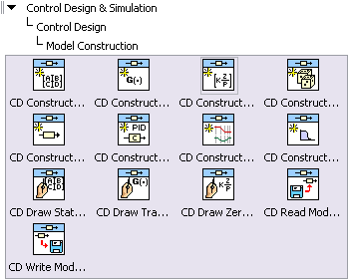
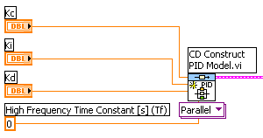
Constructing a PID Controller with Control Design Toolkit
Create a PID model in the form of a transfer function
Model can then be interconnected with plant model
Notes:
The CD Construct PID Model VI creates a PID controller model in the form of a transfer function. This is a polymorphic VI, with options for PID Parallel, PID Academic, and PID Series models. In this course, the PID Parallel model is used. The following equation is used in the PID Parallel Model:
U(s)/E(s) = Kc + K_{i}/s + K_{d}s/(T_{f}s+1)

Slide 39






Control Design Model Interconnection
Graphical
MathScript
Series:
A
B
A
Parallel:
+
B
+
+
A
-
Feedback:
B
Notes:
System models can be interconnected with the LabVIEW Control Design Toolkit either graphically or textually. Graphical interconnections can created with LabVIEW VIs from the Model Interconnection palette. The same interconnections can be created textually within a MathScript node with the textual Control Design functions.
The different types of model interconnection include Series, Parallel, and Feedback connections. Each function has two input models and one output model.
Create a Series model graphically with the CD Series VI, or textually with the Series() function.
Create a Parallel model graphically with the CD Parallel VI, or textually with the Parallel() function.
Create a Feedback model graphically with the CD Feedback VI, or textually with the Feedback() function.
These different forms of interconnections are often used together to create complete control systems by combining controllers and plants with feedback.

Slide 40



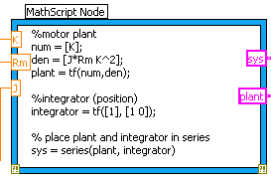
Control Design Model Interconnection (MathScript)
Use MathScript commands to interconnect models
Types of interconnection:
  Series
  Parallel
  Feedback
  Append
Notes:
The Control Design MathScript functions include model interconnection functions. The connect functions will create an output model equivalent to the interconnected input models.

Slide 41
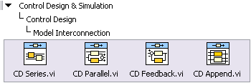

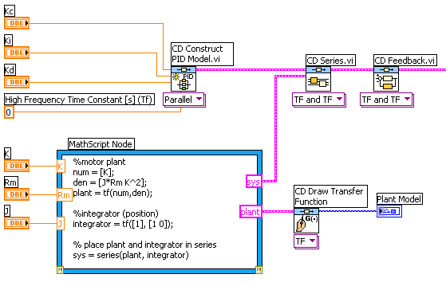

Control Design Model Interconnection (Graphical)
Connect models in series and parallel
Create feedback loops
+
_
Notes:
Control Design models can be interconnected graphically, as well as textually. The Model Interconnection VIs will create an output model equivalent to the interconnected input models.

Slide 42
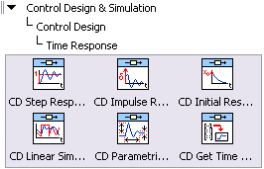

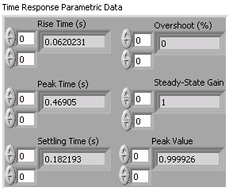
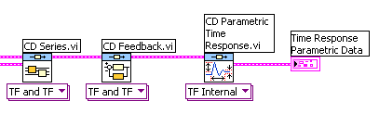
Time Response Analysis
Parametric Time Response
Overshoot
Rise Time
Steady State Error
Notes:
The Time Response VIs can be used to create generic linear simulations and time domain plots for step inputs, impulse inputs, and initial condition responses. Results can be graphed, or parametric data about the linear simulations can be displayed.

Slide 43
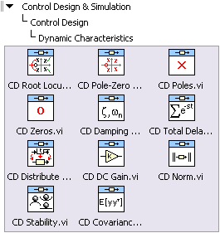
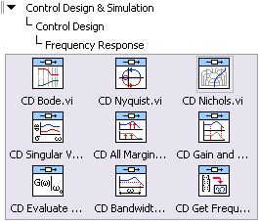




Displaying Frequency Response and Dynamic Characteristics Data
Notes:
CD Root Locus: Used to plot the Evans plot or trajectory of closed-loop poles of a single-input single-output (SISO) system as the feedback gain varies from zero to infinity.
CD Bode: Produces the Bode magnitude and Bode phase plots of the system model on an XY graph.
CD Nyquist: Produces the Nyquist plot of the input system for which this VI plots the imaginary part of the frequency response against its real part.
CD Pole-Zero Map: Plots the poles and zeros of a system model on an XY graph that represents a complex plane.

Slide 44
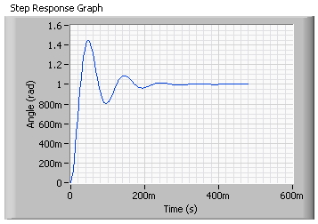
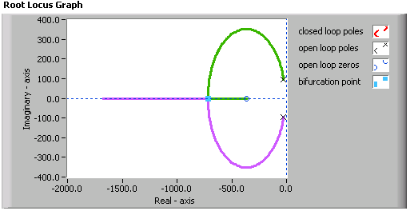
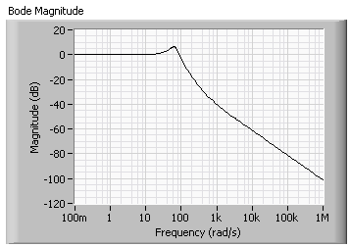
Control Design Analysis and Display
Perform general linear simulations in the time domain
Analyze models in the frequency domain
Calculate dynamic properties of a model

Slide 45
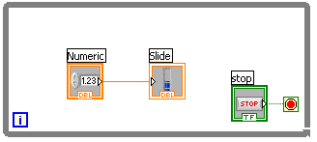
Review: While Loops
terminal counts each iteration
Always runs at least once
Runs until stop condition is met
Notes:
Similar to a Do Loop or a Repeat-Until Loop in text-based programming languages, a While Loop executes a sub diagram until a condition is met. The While Loop executes the sub diagram until the conditional terminal, an input terminal, receives a specific Boolean value. The default behavior and appearance of the conditional terminal is Stop If True. When a conditional terminal is Stop If True, the While Loop executes its sub diagram until the conditional terminal receives a TRUE value. The iteration terminal (an output terminal), shown at left, contains the number of completed iterations. The iteration count always starts at zero. During the first iteration, the iteration terminal returns 0.

Slide 46
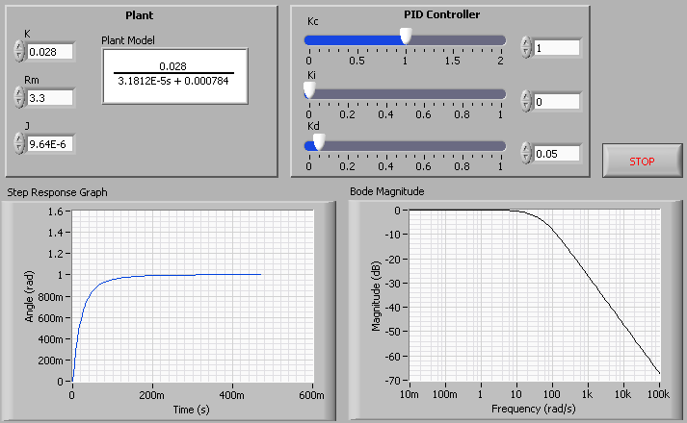
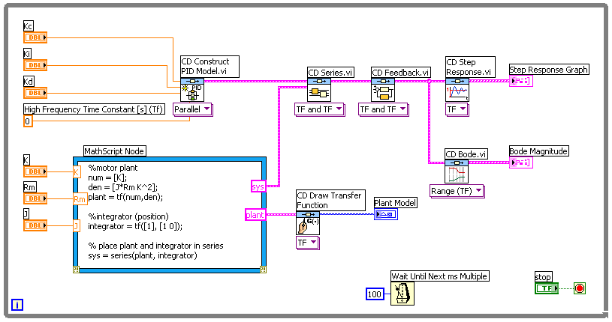
Exercise 2:
Construct a PID Controller
Build a PID controller with Control Design Toolkit.
Create a system that combines PID controller with existing transfer function.
View time and frequency response data.
Notes:
Exercise Instructions can be found at the end of PDF version of this manual or independently as “Updated Exercise Instructions.pdf”.

Slide 47
Step 3: Simulation
Test the controller and incorporate real-world nonlinearities

Slide 48
The Design Process
Modeling – Identify a mathematical representation of the plant
Control Design – Choose a control method and design a controller
Simulation – Employ a point-by-point approach to simulate the system timing with a solver
Tuning and Verification – Introduce real-world nonlinearities, tune, and verify the control algorithm
Deployment – Implement the finalized control system
Test the motor and controller with real-world timing and a continuous time solver.
Notes:
The controller can be optimized by fully understanding the plant. This understanding comes from analysis done in the LabVIEW Control Design Toolkit. Specialized graphs, such as Bode, root-locus, and Nyquist plot, builds intuition of how the plant will behave. Further analysis using these plots with an open loop system with the controller allow stability and other characteristics to be calculated. In this way, we use Control Design to optimize the parameters, in our case the gains P, I, and D. Graphs in the time domain, such as the step response, provide immediate feedback on the ideal behavior of the system, such as rise time, overshoot, settling time, and steady-state error.
We then use the Simulation Module to validate these parameters under real world constraints. One prime example is the maximum and minimum voltage and current available to be supplied to the motor. The voltage limits of the motor define the linear range of operation. Outside of that range, the motor might be damaged or become unpredictable. This is an example of nonlinear behavior, which cannot be modeled using LTI analysis found in the Control Design Toolkit. The Simulation Module allows nonlinearities to be represented in the model. Voltage limits can be modeled using the Saturation block. Other nonlinear behaviors can be written in LabVIEW, MathScript, and the LabVIEW Formula Node, and integrated into the model as a Sub VI.
The optimization process usually includes several iterations between Control Design and Simulation to achieve the desired performance of the system.

Slide 49
LabVIEW Simulation Module
Develop dynamic systems such as motor controllers and hydraulic simulators with LabVIEW
Implement your dynamic systems with real-time I/O using built-in LabVIEW data acquisition functions
Simulate linear, nonlinear, and discrete systems with a wide array of solvers
Deploy dynamic systems to real-time hardware with the NI LabVIEW Real-Time Module
Translate models from The MathWorks, Inc. Simulink® into LabVIEW with built-in utility
Notes:
The National Instruments LabVIEW Simulation Module integrates dynamic system simulation into the LabVIEW environment. As a module, the Simulation Module adds new functionality to core LabVIEW. The simulation loop can model linear, nonlinear, discrete, and continuous plant or control systems in block diagram form. Create models from blocks such as integrator, derivative, and transfer function blocks, and then add graphs and controls to test out the models. Alternatively, you can import models developed in the NI LabVIEW Control Design Toolkit or NI LabVIEW System Identification Toolkit. The interactive nature of the LabVIEW tools allow you to modify parameters while logging the results of the simulation. Models built with the simulation node can also seamlessly download to a real-time target with the LabVIEW Real-Time Module for control prototyping and hardware-in-the-loop (HIL) simulation.

Slide 50

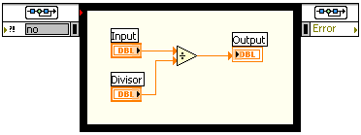
The Simulation Loop
Input Node
Main Loop
Output Node
Built in Differential Equation Solver allows continuous-time system
Similar to a While Loop with a predefined time period
Installed with Simulation Module
Double-click Input Node to configure simulation parameters
Create an indicator on the Output Node to display Simulation errors
Notes:
The simulation loop is the core component of the Simulation Module. It is an “upgraded” version of the while loop which integrates powerful differential equation solvers, internal or external timing features, and cross-platform capabilities. With the Simulation Module, continuous time systems can be run in the discrete digital world. The loop consists of three main parts:
Input node (Left)- allows simulation parameters to be programmatically defined. By default, these parameters are static and can be configured by double-clicking the input node. This node can be expanded by clicking on the bottom border of the node to “grab” the handle and dragging down to show additional parameters.
Main loop – The system to be simulated is placed here.
Output node (Right) – returns any errors that may have happened in the loop, such as an improper transfer function.

Slide 51
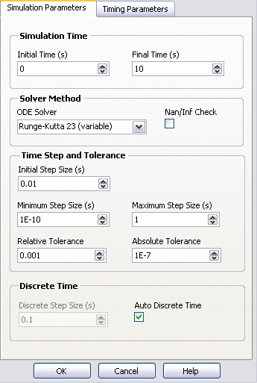
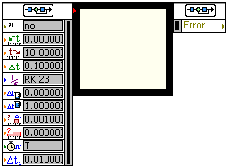
Simulation Loop Parameters
Drag left node to show current parameters and provide inputs for run-time simulation configuration
Double-click Input Node to configure simulation parameters
Notes:
Configuring a Simulation
There are many parameters that can be configured for a given simulation loop.
Simulation Parameters Tab
Simulation Time – Specifies for what period of “simulation time” how long the simulation should run. This time doesn’t necessarily dictate the computation time of the simulation. See Timing Parameters below.
Solver Method – Specifices what Ordinary Differential Equation ODE) solver is used to solve integral and differential type blocks in the simulation. A wide variety of solvers are available.
Time Step and Tolerance – These settings control the window of time steps used by LabVIEW. Typically, the default settings will suffice, but adjust them if necessary.
Discrete Time – While the Default Auto Discrete Time option will typically work for most simulations, you can force LabVIEW to use a specific step size here.
Timing Parameters Tab
Timing – The software timing option is always used when performing simulations. This will solve the equation as fast as the CPU can. To observe a simulation run in “real time”, disable the software timing option and set the timing parameters below.
Loop Timing Source – When implementing a simulation in hardware, change the loop timing source to an available hardware timing. This option can be used to sync the simulation execution with an external time source, such as the operating system clock or even a Data Acquisition board’s clock.
Loop Timing Parameters – These options control how the loop executes with respect to the selected timing source.
For more detailed information on these options, consult the LabVIEW help by clicking the Help button.

Slide 52
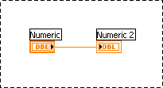
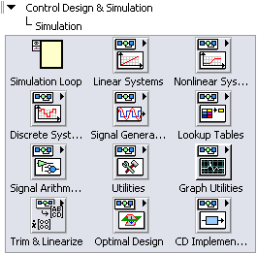



Drawing a Simulation Loop
Select the structure from the Functions Palette
2. Left-click at the top left point
…and drag to the bottom right to enclose code to be looped
Notes:
Place simulation loops in your diagram by selecting them from the Simulation Palette in the Functions palette:
When selected, the mouse cursor becomes a special pointer that you use to enclose the section of code you want to repeat.
Click the mouse button to define the top-left corner, click the mouse button again at the bottom-right corner, and the Simulation Loop boundary is created around the selected code.
Drag or drop additional blocks or functions in the Simulation Loop if needed.

Slide 53


Generating Simulation Input
Simulations can utilize a wide variety of signal sources:
Simulated Signals
  Step Input
  Impulse
  Front Panel User Input
Real World signals
  Data Acquisition Hardware
Notes:
Simulations can utilize a wide variety of signals sources. Simulated signals are useful for characterizing system response and testing corner cases. Chirps provide a useful frequency sweep, and pulses provide good step response information. The indexer is useful for using a predetermined arbitrary signal, and can interpolate between samples for better resolution.
Once the simulation is confirmed, a real world signal can be substituted for the simulation signal. In this configuration, the simulation is now performing calculations based on actual data and is very good for testing the system before controlling the output.

Slide 54




Capturing Simulation Output
Use the Graph Utilities functions to plot one or more signals
Plots are updated as the Simulation Loop executes
Notes:
The Simulation Time Waveform chart is a special numeric indicator that displays one or more plots. The waveform chart is located on the Functions » Control Design & Simulation » Simulation » Graph Utilities » SimTime Waveform palette. Waveform charts can display single or multiple plots. The following front panel shows an example of a multi-plot waveform chart.
You can change the min and max values of either the x or y axis by double clicking on the value with the labeling tool and typing the new value. Similarly, you can change the label of the axis. You can also right click the plot legend and change the style, shape, and color of the trace that is displayed on the chart.

Slide 55

Exercise 3:
Simulate the Motor Control System
+
_
Build a PID controller with Simulation Module.
Create a state model that combines PID controller with existing transfer function.
Use different solver methods in the Simulation loop to optimize performance.
Notes:
Exercise Instructions can be found at the end of PDF version of this manual or independently as “Updated Exercise Instructions.pdf”.

Slide 56
Step 4: Tuning and Verification
Tune the controller behavior to meet design specifications in a realistic environment

Slide 57
The Design Process
Modeling – Identify a mathematical representation of the plant
Control Design – Choose a control method and design a controller
Simulation – Employ a point-by-point approach to simulate the system timing with a solver
Tuning and Verification – Introduce real-world nonlinearities, tune, and verify the control algorithm
Deployment – Implement the finalized control system
Introduce real-world voltage limits and tune control parameters for performance.
Notes:
The controller can be optimized by fully understanding the plant. This understanding comes from analysis done in the LabVIEW Control Design Toolkit. Specialized graphs, such as Bode, root-locus, and Nyquist plot, builds intuition of how the plant will behave. Further analysis using these plots with an open loop system with the controller allow stability and other characteristics to be calculated. In this way, we use Control Design to optimize the parameters, in our case the gains P, I, and D. Graphs in the time domain, such as the step response, provide immediate feedback on the ideal behavior of the system, such as rise time, overshoot, settling time, and steady-state error.
We then use the Simulation Module to validate these parameters under real world constraints. One prime example is the maximum and minimum voltage and current available to be supplied to the motor. The voltage limits of the motor define the linear range of operation. Outside of that range, the motor might be damaged or become unpredictable. This is an example of nonlinear behavior, which cannot be modeled using LTI analysis found in the Control Design Toolkit. The Simulation Module allows nonlinearities to be represented in the model. Voltage limits can be modeled using the Saturation block. Other nonlinear behaviors can be written in LabVIEW, MathScript, and the LabVIEW Formula Node, and integrated into the model as a Sub VI.
The optimization process usually includes several iterations between Control Design and Simulation to achieve the desired performance of the system.

Slide 58


Introducing Nonlinearities
Sources of Nonlinearities
  Saturation
  Noise
  Friction
Nonlinearities cause ideal models and controllers to behave differently in the real world.
Notes:
Nonlinearities cause ideal models and controllers to behave different than expected in the real world. Sources of nonlinearities include saturation, noise, and friction, which cannot be accounted for with a linear system model. The Simulation Module can analyze nonlinear models, allowing us to simulate non-ideal behavior before deployment.

Slide 59


Nonlinearity Example
Introducing a saturation nonlinearity with the Simulation Module can change the behavior of a model dramatically.
Ideal response with linear model in Control Design
Same controller with saturation added in Simulation
K_{c} = 10
K_{i} = 0
K_{d} = 1
Notes:
In this example, a PID controller model is created with the Control Design toolkit. The PID parameters are tuned so that the step response of the system is very close to ideal. The controller model is then used in the Simulation Module with the same PID parameters, where a saturation nonlinearity is introduced. The nonlinearity represents the maximum and minimum voltage (24V, -24V) that can be supplied to the motor. The introduction of this saturation changes the behavior of the system so that it has a far less ideal behavior. This real world constraint of saturation must now be accounted for, and the PID controller parameters need to be readjusted to give a better step response while staying within the constraints dictated by the nonlinearity.

Slide 60
Controller Optimization
Control Design
Tune Controller Parameters
Estimate Performance
Simulation
Introduce Impairments and Nonlinearities
Verify Performance
Controller optimization is an iterative process
Notes:
The controller can be optimized by fully understanding the plant. This understanding comes from analysis done in the LabVIEW Control Design Toolkit. Specialized graphs, such as Bode, root-locus, and Nyquist plots build intuition of how the plant will behave. Further analysis using these plots with an open loop system with the controller allow stability and other characteristics to be calculated. In this way, we use Control Design to optimize the parameters, in our case the gains P, I, and D. Graphs in the time domain, such as the step response, provide immediate feedback on the ideal behavior of the system, such as rise time, overshoot, settling time, and steady-state error.
We then use the Simulation Module to validate these parameters under real world constraints. One prime example is the maximum and minimum voltage and current available to be supplied to the motor. The voltage limits of the motor define the linear range of operation. Outside of that range, the motor might be damaged or become unpredictable. This is an example of nonlinear behavior, which cannot be modeled using LTI (Linear Time Invariant) analysis found in the Control Design Toolkit. The Simulation Module allows nonlinearities to be represented in the model. Voltage limits can be modeled using the Saturation block. Other nonlinear behaviors can be written in LabVIEW, MathScritp, and the LabVIEW Formula Node, and integrated into the model as a Sub VI.
The optimization process usually includes several iterations between Control Design and Simulation to achieve the desired performance of the system.

Slide 61



Tuning your PID Controller
Tune PID controller design using the step response
Begin with Gains set at: K_{c} = 1, K_{i} = 0, and K_{d} = 0
Increase Proportional Gain (K_{c}) to get desired rise time
Increase Derivative Gain (K_{d}) to reduce overshoot and settling time
Increase Integral Gain (K_{i}) to reduce steady-state error if necessary

Slide 62

Exercise 4:
Tune the Controller
+
_
Change Simulation loop to a continuous model
Incorporate nonlinearities into state model.
Tune PID parameters with a continuous input.
Notes:
Exercise Instructions can be found at the end of PDF version of this manual or independently as “Updated Exercise Instructions.pdf”.

Slide 63
Step 5: Deployment
Implement the finalized control system

Slide 64
The Design Process
Modeling – Identify a mathematical representation of the plant
Control Design – Choose a control method and design a controller
Simulation – Employ a point-by-point approach to simulate the system timing with a solver
Tuning and Verification – Introduce real-world nonlinearities, tune, and verify the control algorithm
Deployment – Implement the finalized control system
Deploy the control algorithm on real hardware to control the speed of the motor.
Notes:
The controller can be optimized by fully understanding the plant. This understanding comes from analysis done in the LabVIEW Control Design Toolkit. Specialized graphs, such as Bode, root-locus, and Nyquist plot, builds intuition of how the plant will behave. Further analysis using these plots with an open loop system with the controller allow stability and other characteristics to be calculated. In this way, we use Control Design to optimize the parameters, in our case the gains P, I, and D. Graphs in the time domain, such as the step response, provide immediate feedback on the ideal behavior of the system, such as rise time, overshoot, settling time, and steady-state error.
We then use the Simulation Module to validate these parameters under real world constraints. One prime example is the maximum and minimum voltage and current available to be supplied to the motor. The voltage limits of the motor define the linear range of operation. Outside of that range, the motor might be damaged or become unpredictable. This is an example of nonlinear behavior, which cannot be modeled using LTI analysis found in the Control Design Toolkit. The Simulation Module allows nonlinearities to be represented in the model. Voltage limits can be modeled using the Saturation block. Other nonlinear behaviors can be written in LabVIEW, MathScript, and the LabVIEW Formula Node, and integrated into the model as a Sub VI.
The optimization process usually includes several iterations between Control Design and Simulation to achieve the desired performance of the system.

Slide 65


Control System Deployment Options
Algorithms designed in LabVIEW Control Design Toolkit and Simulation Module can be deployed on a desktop PC, or a Real Time system.
  Desktop PC
    Program runs on Windows
    Input and Output via NI Data Acquisition device
    For example, desktop PC with PCI-6259
  Real Time System
    Program runs on a deterministic operating system
    Input and Output via specialized devices
    For example, CompactRIO controller with selected modules
Notes:
Once a control system is designed with the Control Design Toolkit and the Simulation Module, the algorithm can be deployed to control a real physical system. The deployed algorithm can be run on a desktop PC or a Real Time system.
Running a control system on a desktop PC involves simply replacing the plant model with hardware input and output functions. The system can then be run in LabVIEW just as with the simulated system. One example would be to replace the transfer function representing the plant in the Simulation loop with NI-DAQmx input and output VIs. The DAQmx VIs would control an NI Data Acquisition device like the PCI-6259.
One limitation of running a control system on a desktop PC is the non-deterministic nature of desktop operating systems. Background processes can interrupt the timing of the algorithm, which can cause inaccurate results. National Instruments provides Real Time standalone platforms, such as the CompactRIO, that ensure predictable timing of onboard processes. This provides superior performance with applications that require high speed and high accuracy control.

Slide 66


Deployment
Moving from a simulated model to a real life model
Replace Plant Model with Hardware I/O
Make sure Hardware I/O timing matches Simulation Loop timing
Notes:
The LabVIEW Simulation Module can be used to control real life systems as well as simulated models. To migrate from simulated control to real life control, the plant model can be replaced with hardware input and output functions. In this case, we will replace the transfer function representing the motor with DAQmx input and output VIs that control the actual motor.
Timing is an important consideration when deploying with the Simulation Module. Since the Simulation loop uses a built in ODE solver with time steps, it is important to set the Simulation Parameters and the Timing Parameters of the loop to have the same time step. Data acquisition tasks typically use timing parameters, so it is also important to equate the Simulation loop timing with the data acquisition timing.

Slide 67
Exercise 5: (Optional)
Use the Controller in a Real Life System
+
_
Replace the plant model with the real life motor.
Test the behavior of the motor, and compare to the original plant model.
Notes:
Exercise 5:
Note: This exercise requires the NI ELVIS, Quanser QNET DC Motor, and an NI PCI DAQ device. NI-DAQmx 8.3 or later must also be installed.
Open Exercise 4.vi.
Save the VI as Exercise 5.vi.
Go to the block diagram and select the Transfer Function VI inside the Simulation loop. Select Edit» Create Simulation Subsystem. This will create a subsystem that contains the Transfer Function VI, which can be edited in a separate VI.
Right-click the new subsystem, and select “Open Subsystem” from the shortcut menu. This will open the subsystem containing the Transfer Function.
Save the new subsystem as Ex 5 Plant.vi. Go to the block diagram.
Delete the Transfer Function VI. Remove any broken wires (<CTRL-B>).
Place a DAQ Assistant on the block diagram: Measurement I/O » NI-DAQmx » DAQ Assistant.

Slide 68
Hidden Notes Page
Notes:
Configure the DAQ Assistant for scaled analog output:
In the configuration window, select Analog Output » Voltage. Select analog output channel 0 of the NI PCI DAQ device. Click Finish.
In the Voltage Output Setup section, select Create New in the Custom Scaling pull down menu.
Select Linear, then name the scale “voltageout”. Click Finish.
Set the Slope to 2.2. Click OK.
Set the Signal Output Range MAX and MIN values to 22 and -22, respectively.
In the Timing Settings section, select 1 Sample (On Demand) for Generation Mode.
Click OK to exit the DAQ Assistant.
Wire the numeric control of Ex 5 Plant.vi to the data input of the DAQ Assistant.
Place a second DAQ Assistant on the block diagram: Measurement I/O » NI-DAQmx » DAQ Assistant.
Configure the DAQ Assistant for scaled analog input:
In the configuration window, select Analog Input » Voltage. Select analog input channel 4 of the NI PCI DAQ device. Click Finish.
In the Voltage Input Setup section, select Create New in the Custom Scaling pull down menu.
Select Linear, then name the scale “velocity”. Click Finish.
Set the Slope to 109.9. Click OK.
Set the Signal Output Range MAX and MIN values to 1099 and -1099, respectively.
In the Timing Settings section, select 1 Sample (On Demand) for Acquisition Mode.
Click OK to exit the DAQ Assistant.
Wire the numeric indicator of Ex 5 Plant.vi to the data output of the DAQ Assistant.
Save both Exercise 5.vi and Ex 5 Plant.vi.
Make sure that the NI ELVIS, Quanser DC Motor, and NI DAQ device are connected and powered on. The NI ELVIS should be set to “Bypass” mode.
Run the VI. The DC motor should respond similarly to the simulated motor in the previous exercise.
End of Exercise 5

Slide 69


Where Can I Learn More?
We have only begun to explore the many opportunities for control and simulation within LabVIEW. Learn more by visiting the following links:
System Identification Toolkit:
  http://sine.ni.com/nips/cds/view/p/lang/en/nid/13853
Control Design Toolkit:
  http://sine.ni.com/nips/cds/view/p/lang/en/nid/13854
Simulation Module:
  http://sine.ni.com/nips/cds/view/p/lang/en/nid/13852
LabVIEW Real-Time Module:
  http://www.ni.com/realtime
Data Acquisition and Control Hardware:
  http://www.ni.com/dataacquisition
CompactRIO Real-Time Platform:
  http://www.ni.com/compactrio

Slide 70




Educational Control Partners
Quanser – www.quanser.com
  LabVIEW based curriculum and solutions
  Linear, rotary, mechatronic and specialty control experiments
  Uniquely modular, allowing multiple configurations for a wide range of experiments
3 Degree of
Freedom
Helicopter
Quanser QNET – 010
DC Motor Control
Modular
Linear Pendulum
Quanser QNET – 011
Rotary Inverted Pendulum
Notes:
Quanser Control Challenges
Implement and evaluate feedback strategies such as PID, LQC, adaptive or nonlinear controllers with Quanser’s linear, rotary, specialty, mechatronics and custom control experiments. Our systems are uniquely modular and use the same base components that can be multi-purposed throughout a wide range of experiment configurations. So by adding and removing various modules you extend the functionality of your investment and more importantly create a greater variety of experiments and challenges to explore – no other solution provider comes close to providing this kind of flexibility.
Quanser Engineering Trainers For NI ELVIS (QNET)
The Quanser Engineering Trainers For NI ELVIS (QNET) Series is a new cost-effective line of controls education experiments that considerably increases the value of your investment in NI ELVIS & LabVIEW software. The boards are easily connected to the NI ELVIS workstation to facilitate a diverse range of controls education experiments, thereby extending the functionality of the NI platform.

Slide 71





Educational Control Partners
Educational Control Products (ECP) – www.ecpsystems.com
  LabVIEW control templates
  Intuitive systems provide unparalleled flexibility and dynamic fidelity
  In use at over 400 universities and industrial sites world-wide
  Proven to accelerate student learning while saving instructor time
ECP Model 220
Industrial Plant
ECP Model 750
Gyroscope
ECP Model 730
Magnetic Levitation
ECP Model 205
Torsional Plant
Notes:
LabVIEW ECP Real-Time Control Option
In addition to the fully integrated ECP Executive® programs, National Instruments LabVIEW and NI data acquisition hardware can be used to develop and deploy real-time control algorithms to control select ECP electromechanical plants. The LabVIEW® environment allows for the design and simulation of control algorithms with seamless real-time deployment and execution. This approach allows for multiple levels of learning by allowing students to simply modify controller parameters on a graphical user interface or to design and create their own controller. It allows students to gain familiarity with the LabVIEW software and NI hardware that is widely used in industrial control applications.

Slide 72


Additional Resources
NI Academic Controls Web
  http://www.ni.com/academic/controls
LabVIEW Student Edition DVD with Control Design and Simulation
  http://www.academicsuperstore.com/ search: LabVIEW
  Part Number: 752412
Connexions: Full LabVIEW Introductory Course
  www.cnx.rice.edu
  Or search for “LabVIEW basics”
LabVIEW Certification
  LabVIEW Fundamentals Exam (free on www.ni.com/academic)
  Certified LabVIEW Associate Developer Exam (industry recognized certification )
Notes:
http://www.ni.com/academic/controls

